Slide 1
Business Intelligence Concepts, Tools, and Applications
Week 5: BI Maturity, Strategy, and Summative Project
Lesson 1: BI Maturity

Slide 2
BI Maturity
Learning Objectives
Identify the five levels of BI and BPM maturity and explain the characteristics of each stage
Summarize the main factors that impact BI maturity within an organization
List both the main challenges of pervasive Learn the elements of pervasive BI solutions and potential solutions.
Notes:
The goal is to put BI in the hands of more people, and thereby “democratize BI for the masses.”
It is also called transformative BI

Slide 3
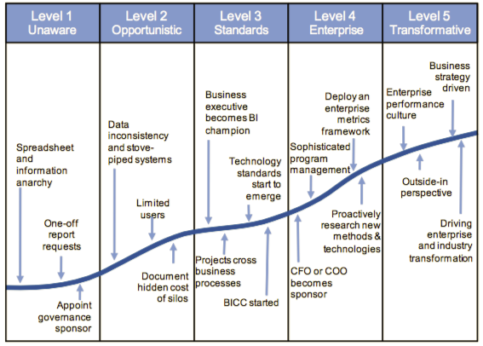
Gartner’s Maturity Model for BI and BPM
Source: Hagerty, J. and Hostmann, B., 2010. IT Score Overview for Business Intelligence and Performance Management. Gartner, Inc. Available at: http://www.gartner.com/id=1433813
Notes:
Source: Hagerty, J. and Hostmann, B., 2010. IT Score Overview for Business Intelligence and Performance Management. Gartner, Inc. Available at:
http://www.gartner.com/id=1433813

Slide 4
Level 1 Unaware
Usage of spreadsheets is high, while use of reporting tools is limited.
A company does not have defined metrics for performance management.
A company is not devoted to and does not understand the importance of the BI and Performance Management.

Slide 5
Level 2 Opportunistic (Tactical)
Companies at this level start to invest into BI
Use metrics on the department level only. Common metrics do not exist or are inconsistent.
Use data, tools, and applications in “silos”
Use off-the-shelf software, with few or no modifications, to accommodate company needs.
Users often not skilled enough in order to take advantage of the system.
Management does not trust the quality and consistency of the information provided.
Have low support and inadequate funding of BI projects.
Notes:
Source: Hagerty, J. and Hostmann, B., 2010. IT Score Overview for Business Intelligence and Performance Management. Gartner, Inc. Available at:
http://www.gartner.com/id=1433813

Slide 6
Level 3 Standards (focused)
Sponsorship usually comes from a business unit or department or is a member of senior management responsible for IT.
Management dashboards are often requested at this level. Their goal is to optimize the efficiency of individual departments or business units, but is not related to the broader company goals.
Inconsistencies in metrics and/or goals of individual business units or departments are very common.
Users are trained for basic functionalities of data retrieval systems.
Funding of BI projects comes from one or more business units.
Data is not integrated at this stage and is available through stovepipe solutions, usually not integrated among each other.
Business Intelligence Competency Center (BICC) is being formed, where experts from business and IT are joined together in order to fulfill the user needs.
Notes:
Source: Hagerty, J. and Hostmann, B., 2010. IT Score Overview for Business Intelligence and Performance Management. Gartner, Inc. Available at:
http://www.gartner.com/id=1433813
These solutions are often closed software applications, covering only a fraction of business, but usually from the very data capture to reporting.

Slide 7
Level 4 Enterprise (Strategic)
Clear business strategy for BI development with sponsors from the highest management.
Include BI and PM into critical business processes.
Usage of BI and PM is often extended to suppliers, business partners, and occasionally to customers.
BICC centers are formed.
A strategic framework is established that combines financial and other strategic goals with measurements on the operational, departmental and functional level of the company.
Data management policy and data quality metrics are in place. Data quality is under constant supervision.
Strategic information becomes trustworthy and is used for strategic decision-making.
Users are adequately trained for data processing and are able to use them effectively for strategic and tactical decisions.
Notes:
Source: Hagerty, J. and Hostmann, B., 2010. IT Score Overview for Business Intelligence and Performance Management. Gartner, Inc. Available at:
http://www.gartner.com/id=1433813
Information is available to all employees of the company.
BICC include experts from business areas and IT, having enough resources and funding to achieve their goals.

Slide 8
Level 5 Transformative (Pervasive)
BI and PM become pervasive across all areas of the business and across part of the corporate culture.
BI and PM systems become a part of the business processes. They provide flexibility to adapt to the fast business changes and information demands.
A company has proactive and dynamic BICC. Information is trustworthy and used at different levels of the company.
Users are well trained and measured by their ability to support data quality and policy management.
Users at different levels have access to information and analysis needed for creating a business value and influence business performance.
Results are measurable and linked to specific goals. Usage of BI is available to suppliers, business partners and customers.
Notes:
Source: Hagerty, J. and Hostmann, B., 2010. IT Score Overview for Business Intelligence and Performance Management. Gartner, Inc. Available at:
http://www.gartner.com/id=1433813

Slide 9
BI Maturity Factors
According to Watson and Wixom (2007) The following are critical success factor to move to higher levels of BI Maturity:
Senior management perceives and treats BI as a strategic resource has an enterprise-wide strategy.
There is alignment between BI strategy and overall IT strategy and enterprise goals. BI delivers high business value.
A culture of information-based decision making exists.
Decisions are driven by the numbers.
BI governance is effective.
The enterprise wide data infrastructure is effective.
Source: Adopted from Watson, H.J., and Wixom, B. H. Enterprise Agility and Mature BI Capabilities, BUSINESS INTELLIGENCE Journal, vol. 12, No. 3, 2007.
Notes:
Source Watson, H.J., and Wixom (2007 B. H. Enterprise Agility and Mature BI Capabilities, BUSINESS INTELLIGENCE Journal, vol. 12, No. 3,

Slide 10
BI Maturity Factors- Continued
Data quality is high for success of BI projects
BI strategy incorporate data architecture and data integration for stable production and development environment
There is widespread use of BI. BI is pervasive throughout the organization
The BI staff and users work in a collaborative environment
People, tools, data, and methodologies are available to manage risk, schedule, cost, and effort
A strong portfolio of business-driven BI applications exists
Source: Adopted from Watson, H.J., and Wixom, B. H. Enterprise Agility and Mature BI Capabilities, BUSINESS INTELLIGENCE Journal, vol. 12, No. 3, 2007.
Notes:
From Watson, H.J., and Wixom, B. H. Enterprise Agility and Mature BI Capabilities, BUSINESS INTELLIGENCE Journal, vol. 12, No. 3, 2007.
.

Slide 11
BI Maturity Major Challenges
The time, cost, and complexity of deployment
The time and cost of user training and support
The difficulty of using BI tools
Source: Adopted from Watson, H.J., and Wixom, B. H. Enterprise Agility and Mature BI Capabilities, BUSINESS INTELLIGENCE Journal, vol. 12, No. 3, 2007.

Slide 12
BI Maturity Solutions
Open-source BI software
Web based applications
Implementing dashboards and scorecards
Integrating BI with Microsoft Office
Embedding BI into business processes
Making BI tools easier to use
Source: Adopted from Watson, H.J., and Wixom, B. H. Enterprise Agility and Mature BI Capabilities, BUSINESS INTELLIGENCE Journal, vol. 12, No. 3, 2007.

Slide 13
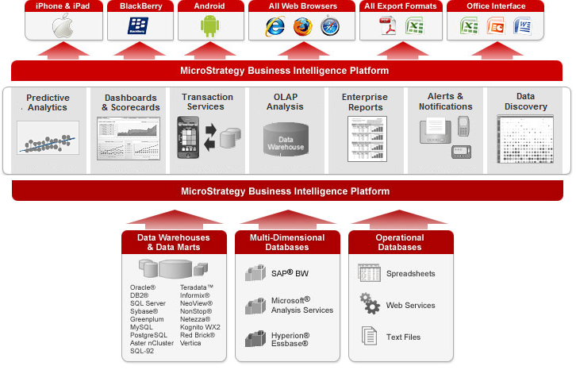
Business Intelligence and Analytics Are Readily Available Across All Interfaces
Notes:
In today’s highly competitive environment, where companies need ready-to-deploy, powerful solutions to incorporate BI into their enterprise portals, MicroStrategy’s pre-built portlets assure seamless integration with corporate portals, such as IBM WebSphere®, Microsoft® Office SharePoint®, Oracle™ WebLogic®, SAP® NetWeaver, Liferay Portal, and DotNetNuke Web Content Management Systems. MicroStrategy-enriched portals enable users to have access to all 5 Styles of BI: enterprise reporting, dashboards and scorecards, ad hoc query and OLAP analysis, advanced analysis and data mining, and alerting and report delivery. Through portals, all of MicroStrategy’s BI functionality, including intuitive drag-and-drop and context-sensitive right-click menu capabilities, transparently carry through and express themselves in these widely adopted corporate portals, while leveraging the collaborative and personalization capabilities of the portal.
Differentiator – Dashboards Embedded in Office and Email
The Best In Class Approach Is:
Allow dashboards to be embedded in the body of an email, or embedded within a PowerPoint, Word, or Excel document.
(++) Which Is Important Because:
Offline analysis with interactive dashboards is possible.
◊ Other Alternatives In the Market Are:
Only URLs to Web-based dashboards can be emailed.
Dashboards can be emailed only as part of an email attachment.
Only static, non-interactive dashboards can be embedded in a Microsoft Office document.
(--) Which Are Less Optimal Because:
It is much easier for end users to see and interact with dashboards within context, in the email or Word document, instead of having to open up another interface to view the dashboard.
If interactive dashboards cannot be embedded in an email or Office document, then offline analysis is not possible.
Differentiator – Microsoft Office Integration The Death of Spread Mart Hell – The Rise Of A Single Version Of The Truth
The Best In Class Approach Is:
Any report can be executed and refreshed directly from Microsoft Office. With object prompts, new reports can be created within Microsoft Office.
Microsoft Office Integration Preserving the Integrity and Security of Centralized Metadata and Data Access.
Formatting Changes in Microsoft Office Are Preserved After Data Refreshes
(++) Which Is Important Because:
Centralized business layer of metadata provides a single version of the truth
Up-to-date reports can be viewed within Microsoft Office, without having to leave the Office environment.
Preservation of formatting changes maximize user adoption and minimize frustration
◊ Other Alternatives In the Market Are:
Reports must be exported to Microsoft Office from the BI tool
New reports cannot be created within Microsoft Office.
Do not allow to keep formatting changes after refreshing the data from Office
(--) Which Are Less Optimal Approaches In the Market Because:
If reports have to be exported to Microsoft Office, then users would have to switch back-and-forth between Office and the BI tool to get updated reports in Office. This process is cumbersome.
Microsoft Office users are limited to seeing reports that have already been pre-defined in the BI tool. Any new report that Office users want to see will require them to either switch to the BI tool to create the report, or to ask a developer to create the report.
Frustrate end users by making it difficult to preserve their formatting changes after data refreshes from Office
The MicroStrategy BI Platform enables organizations to analyze vast amounts of data and distribute business insight throughout the enterprise.
The MicroStrategy Mobile Platform lets organizations rapidly build enterprise-caliber mobile applications needed to mobilize business processes and information. MicroStrategy Applications are a set of application services designed to help enterprises deploy mobile commerce and loyalty services, build mobile identity and cyber security services, as well as generate real-time insights into consumer preferences.
Now we are seeing most BI solutions recognizing the mobile opportunity and offering a mobile presentation component. And some broader solution platforms are even offering mobile application development tools that are in many ways the equal of solutions
It’s important to realize that MicroStrategy has multiple layers within it’s architecture, and all of these layers are made of reusable building blocks that construct the BI environment. This is why MicroStrategy allows you to navigate all the BI Styles without having to change interface or applications. This is also why you can see the same reports regardless of the interface or delivery mechanism used to distribute the information.
.

